Slide 1

Client Update
January 2020

Slide 2
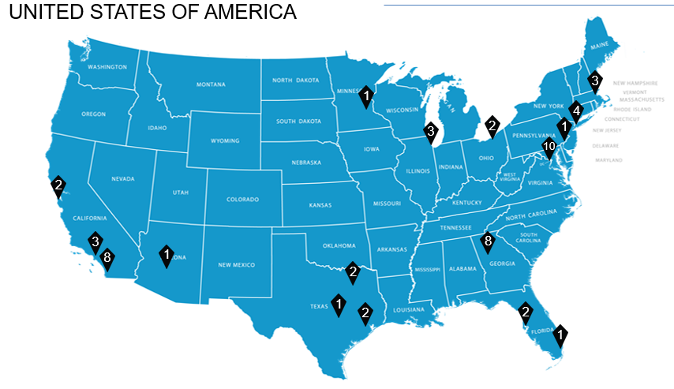
U.S. CoStar Market Analytics Locations
Atlanta
Austin
Boston
Chicago
Cleveland
Dallas
Houston
Los Angeles
Miami
Minneapolis
New York
Philadelphia
Phoenix
San Diego
Tampa
Washington, D.C.

Slide 3
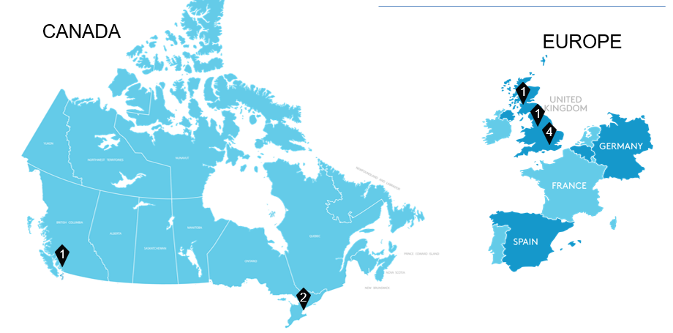
International CoStar Market Analytics Locations
Glasgow
London
Manchester
Toronto
Vancouver

Slide 4

Itinerary
Economy
Population Growth
Demographics
Multifamily
Office
Industrial

Slide 5
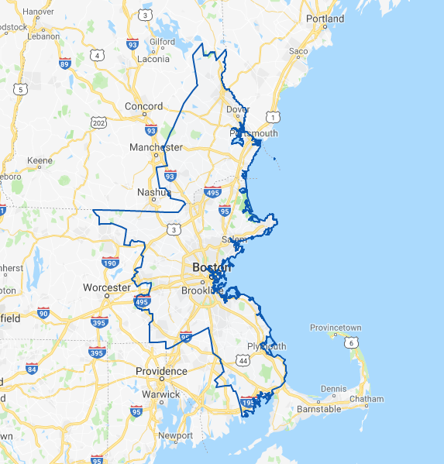
Boston

Slide 6
NATIONAL
ECONOMY

Slide 7
We Are Now In The Longest Expansion in U.S. History
Notes:
L:\CoStar Market Analytics\Works in Progress\New England Analytics\Big Books and Related Material\Peter's Excel\Haver Work\Economic Big Book.xlsx

Slide 8
We Are Now In The Longest Expansion in U.S. History
Notes:
L:\CoStar Market Analytics\Works in Progress\New England Analytics\Big Books and Related Material\Peter's Excel\Haver Work\Economic Big Book.xlsx

Slide 9
Without International Immigration We'll Shrink In Population
United States Fertility Rate
Notes:
L:\CoStar Market Analytics\Works in Progress\New England Analytics\Big Books and Related Material\Mark's Excel\Big Book, 19Q1, Economy, Boston.xlsx

Slide 10
But We’re Still Doing Better Than Some Countries
Fertility Rates In The United States, Japan, and Italy
Notes:
L:\CoStar Market Analytics\Works in Progress\New England Analytics\Big Books and Related Material\Mark's Excel\Big Book, 19Q1, Economy, Boston.xlsx

Slide 11
International Migration Is Getting Dangerously Low
Number Of International Migrants By Year
Notes:
L:\CoStar Market Analytics\Works in Progress\New England Analytics\Big Books and Related Material\Peter's Excel\Haver Work\Economic Big Book.xlsx

Slide 12
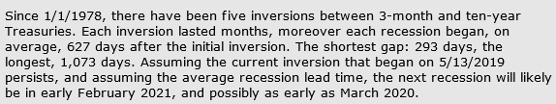
Both The 2 Year And 3-Month Inverted In 2019
Spread Between Treasury Yields: 2YR vs 10YR and 3-Month vs 10YR
Inversion
2YR vs 10YR inverts on a daily basis, but not for the monthly average
Notes:
L:\CoStar Market Analytics\Works in Progress\New England Analytics\Big Books and Related Material\Peter's Excel\Haver Work\Economic Big Book.xlsx

Slide 13
The Depth Of The Inversion Matters
10YR Treasury Minus The 2YR Treasury
Notes:
L:\CoStar Market Analytics\Works in Progress\New England Analytics\Big Books and Related Material\Peter's Excel\Haver Work\Economic Big Book.xlsx

Slide 14
BOSTON ECONOMY

Slide 15
Boston Had Been Slightly Outpacing The Rest Of The U.S.
Annual Growth In Total Employment, Boston vs. The U.S. Average
Sources: CoStar, Oxford Economics, BLS
19Q3
Notes:
L:\CoStar Market Analytics\Works in Progress\New England Analytics\Big Books and Related Material\Mark's Excel\Big Book, 19Q2, Economy, Boston.xlsx

Slide 16
Boston Had Been Slightly Outpacing The Rest Of The U.S.
Annual Growth In Total Employment, Boston vs. The U.S. Average
Sources: CoStar, Oxford Economics, BLS
19Q3
Notes:
L:\CoStar Market Analytics\Works in Progress\New England Analytics\Big Books and Related Material\Mark's Excel\Big Book, 19Q2, Economy, Boston.xlsx

Slide 17
POPULATION GROWTH:
A DEEP DIVE

Slide 18
Populations Growth Is The Best It's Been Since The 1960's
Annual Growth In Population, Boston vs. The U.S. Average
As Of 19Q3
Notes:
L:\CoStar Market Analytics\Works in Progress\New England Analytics\Big Books and Related Material\Mark's Excel\Big Book, 18Q4, Economy, Boston.xlsx

Slide 19
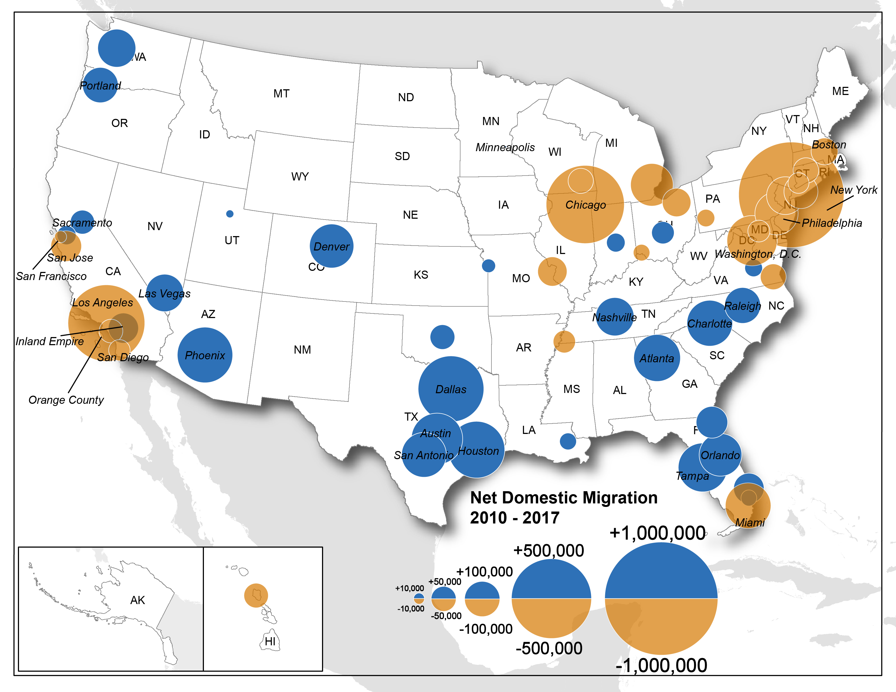
Core Coastal Markets Losing Domestic Residents
U.S. 54 Major Metros Cumulative Domestic Migration From 2010-17
Sources: BOC; CoStar Portfolio Strategy
As of 18Q1
Notes:
P:\Advisory\Apartments\Millennial Movement\2010-17 Population Change.xlsx

Slide 20
Gateway Cities Are Immigration Hubs
U.S. Major Metros Cumulative International Migration From 2010-17
Notes:
P:\Advisory\Apartments\Millennial Movement\2010-17 Population Change.xlsx

Slide 21
International Net Migration Is Saving The Day
Net Migration In Boston Domestic vs. International
Notes:
L:\CoStar Market Analytics\Works in Progress\New England Analytics\Big Books and Related Material\Mark's Excel\Big Book, 18Q4, Economy, Boston.xlsx

Slide 22
AGE RELATED DEMOGRAPHICS

Slide 23
As the Millennials Age, They Will Impact Commercial Real Estate
Number Of Person’s By Single Year Age – US
Notes:
L:\CoStar Market Analytics\Works in Progress\New England Analytics\Big Books and Related Material\Peter's Excel\Haver Work\Economic Big Book.xlsx

Slide 24
The Labor force Will Grow Very Slowly For A Very Long Time
Working Age Population In US Aged 20-64
Result Of Fertility Rate Drop In 1960
Notes:
L:\CoStar Market Analytics\Works in Progress\New England Analytics\Big Books and Related Material\Peter's Excel\Test Work\Q4 Analytics update through Haver.xlsx

Slide 25
Prime Renting Cohort Will Begin To Shrink Across US
Prime Renting Population In US Aged 20-34
Notes:
L:\CoStar Market Analytics\Works in Progress\New England Analytics\Big Books and Related Material\Peter's Excel\Test Work\Q4 Analytics update through Haver.xlsx

Slide 26
Homeownership Ticking Up In Boston And Across The U.S.
Homeownership Rate – US and Metropolitan Boston (3-Q Moving Average)
Notes:
L:\CoStar Market Analytics\Works in Progress\New England Analytics\Big Books and Related Material\Peter's Excel\Haver Work\Economic Big Book.xlsx

Slide 27
METRO LEVEL
MF TRENDS

Slide 28
Retail Supply Growth Is Down
Boston Retail Supply Growth, 1984 To 2022
Notes:
L:\CoStar Market Analytics\Works in Progress\New England Analytics\Big Books and Related Material\Mark's Excel\Big Book, 18Q3, All Metros, RET, Data Extract.xlsx
Notes 1
Notes 2
Notes 3
Notes 4
Notes 5
Notes 6

Slide 29
Office Supply Is Down Compared To Previous Cycles
Boston Office: Annual Percentage Inventory Growth
Notes:
L:\CoStar Market Analytics\Works in Progress\New England Analytics\Big Books and Related Material\Mark's Excel\Big Book, 19Q3, OFF, Metro Level.xlsx

Slide 30
Industrial Supply Is Practically Non-Existant
Metro Boston: Industrial Supply Growth
Notes:
L:\CoStar Market Analytics\Works in Progress\New England Analytics\Big Books and Related Material\Mark's Excel\Big Book, 19Q3, IND, Metro Level, All Metros.xlsx
Notes 1
Notes 2
Notes 3
Notes 4
Notes 5
Notes 6

Slide 31
Never A Cycle Like This In Our Lifetimes
Boston: Annual Apartment Supply, 1984 to 2022
Notes:
L:\CoStar Market Analytics\Works in Progress\New England Analytics\Big Books and Related Material\Mark's Excel\Big Book, 19Q3, APT, Metro Level, All Metros.xlsx
Notes 1
Notes 2
Notes 3
Notes 4
Notes 5
Notes 6

Slide 32
Apartment Inventory: Units Built By Decade
Notes:
\\Dcfile1\share\CoStar Market Analytics\Specialization Initiatives\Presentations and Webinars\Metro Big Books 2.0\PRELIM_Apartment Metro BB Zebra Striping 20Q1.xlsm

Slide 33
Difficult To Build In Boston? Not This Cycle
Avergage Annual Inventory Growth From 1982Q1 To 2011Q4 vs. 2011Q4To 2019Q2
Notes:
L:\CoStar Market Analytics\Works in Progress\New England Analytics\Big Books and Related Material\Mark's Excel\Big Book, 19Q2, APT, Metro Level, All Metros.xlsx
2011Q4
To
2019Q2

Slide 34
Difficult To Build In Boston? Not This Cycle
Cumulative Inventory Growth From 2013Q4 To 2019Q2
Notes:
L:\CoStar Market Analytics\Works in Progress\New England Analytics\Big Books and Related Material\Mark's Excel\Big Book, 19Q2, APT, Metro Level, All Metros.xlsx

Slide 35
Rent Growth Has Been Good, But The Best Rent Growth Is Behind Us
Boston - MA: Apartment Supply, Demand, Vacancy, And Rent Growth
Notes:
L:\CoStar Market Analytics\Works in Progress\New England Analytics\Big Books and Related Material\Mark's Excel\Big Book, 19Q3, APT, Metro Level, All Metros.xlsx

Slide 36
Rent Growth For Major Metros
Cumulative Rent Growth From 2008Q3 To 2019Q3
Notes:
L:\CoStar Market Analytics\Works in Progress\New England Analytics\Big Books and Related Material\Mark's Excel\Big Book, 19Q3, APT, Metro Level, All Metros.xlsx

Slide 37
Class B Has Out Performed, But This May Not Be Capturing Renovations
Annual Rent Growth By Class For The United States
Notes:
L:\CoStar Market Analytics\Works in Progress\New England Analytics\Big Books and Related Material\Mark's Excel\Big Book, 19Q2, APT, Metro Level, All Metros.xlsx

Slide 38
West Coast Leads The Way
Cumulative Price Growth From 2007Q3 To 2019Q3
Notes:
L:\CoStar Market Analytics\Works in Progress\New England Analytics\Big Books and Related Material\Mark's Excel\Big Book, 19Q3, APT, Metro Level, All Metros.xlsx

Slide 39
BOSTON OFFICE

Slide 40
Office Supply Is Down Compared To Previous Cycles
Boston Office: Annual Percentage Inventory Growth
Notes:
L:\CoStar Market Analytics\Works in Progress\New England Analytics\Big Books and Related Material\Mark's Excel\Big Book, 19Q3, OFF, Metro Level.xlsx

Slide 41
Despite Less Supply Than Previous Cycles, Boston Is Outpacing The National Average
Cumulative Inventory Growth From 2009Q4 To 2019Q3
Notes:
L:\CoStar Market Analytics\Works in Progress\New England Analytics\Big Books and Related Material\Mark's Excel\Big Book, 19Q3, OFF, Metro Level.xlsx

Slide 42
Similar To Apartment The Best Rent Growth Was in 2015
Boston - MA: Office Supply, Demand, Vacancy, And Rent Growth
Notes:
L:\CoStar Market Analytics\Works in Progress\New England Analytics\Big Books and Related Material\Mark's Excel\Big Book, 19Q3, OFF, Metro Level.xlsx
Notes 1
Notes 2
Notes 3
Notes 4
Notes 5
Notes 6
Notes 7

Slide 43
BOSTON
INDUSTRIAL

Slide 44
Industrial Rent Growth Is Practically Non-Existant
Metro Boston: Industrial Supply Growth
Notes:
L:\CoStar Market Analytics\Works in Progress\New England Analytics\Big Books and Related Material\Mark's Excel\Big Book, 19Q3, IND, Metro Level, All Metros.xlsx
Notes 1
Notes 2
Notes 3
Notes 4
Notes 5
Notes 6

Slide 45
Rent Growth For Industrial Is The Best Of Any Property Type By A Wide Margin
Boston - MA: Industrial Supply, Demand, Vacancy, And Rent Growth
Notes:
L:\CoStar Market Analytics\Works in Progress\New England Analytics\Big Books and Related Material\Mark's Excel\Big Book, 19Q3, IND, Metro Level, All Metros.xlsx
Notes 1
Notes 2
Notes 3
Notes 4
Notes 5
Notes 6
Notes 7

